Slide 1

ITBW21: Project Proposal Presentation
Is Singapore a good place to work/live in ?
By Darren, Karthik, Gabriel, Victor

Slide 2

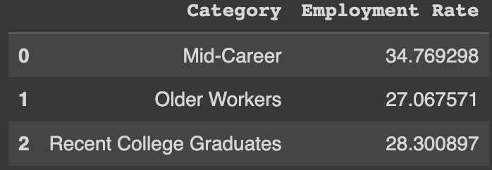
Target Audience
Fresh Graduates in Singapore
Constitute a significant portion of the workforce, with an employment rate of 28.3%
Second to Mid-Career category
Understand and provide latest insights on education and employment opportunities
Notes:
Although their employment rate stands next to mid career workers, they still constitute a significant group and are worth considering when evaluating the the job market and living conditions in Singapore.

Slide 3
Economic Environment by Darren
Spending power of an individual directly impacts quality of life
Wage premium of a university degree
Fresh university graduates make up the largest increase in population percentages.
By examining the largest percentage of the workforce we can ascertain the trend that the quality of life in Singapore is trending towards.

Slide 4
Economic Environment by Darren
Survey and Interview Results
Survey
31 responses were of bachelors degree holders
Assumption: Basic necessities for living in Singapore are food, water and electricity.
Interview
Median Salary of a bachelor degree holder is 4.2K per month.
Our interviewee mentioned that the cost of basic necessities is between 1000 to 1500.

Slide 5
Housing by Karthik
Availability and Affordability of housing contributes to the happiness and well-being
Homeownership levels show the stability of the country on multiple levels including economically and socially.
Financial stability: Build equity as property value could potentially increases over time
Social stability: Sense of community and belonging
Overall, Housing is an important foundation for people to build their lives upon, and access to affordable, quality housing can be a key determinant of happiness and well-being.

Slide 6
Housing by Karthik
Survey and Interview Results
Survey
Those aged 21 to 25 were the most dissatisfied with their housing options
In this age group a lot of people felt that cost is the most important factor, which could have contributed to their dissatisfaction
Interview
Interviewees also said that the housing market in Singapore is facing high demand and limited supply, leading to long waiting times and high resale prices, causing difficulties for recent graduates starting families

Slide 7
Transportation and public service by Gabriel
The efficiency of the transportation and public services system affects the quality of life
When transportation and public services are reliable and efficient, people are able to go about their daily lives more easily and have more time for the things that matter to them. This can be important factors in overall happiness.
Access to quality transportation and public services can also reduce stress and improve physical and mental health by making it easier for people to get to necessary appointments and services.

Slide 8
Transportation and public service by Gabriel
Survey and interview results
Survey
Those age 26 - 30 believe that public services and transportation is more efficient than satisfactory
They may be more likely to notice and be bothered by delays, overcrowding, or other inefficiencies in these services and may be more likely to express their dissatisfaction with them.
Interview
The interviewee mentioned 2 difficulties with the public transport system which bothered him when commuting to work/school:
The occasional breakdown of the MRT
High volume of commuters during rush hour

Slide 9
Schools and Education by Victor
Level of Educational Qualification impacts the quality of life
Higher levels of education may lead to better job opportunities and higher salaries, which can improve financial stability and increase overall quality of life.
Higher levels of education may also be associated with a greater sense of accomplishment and personal growth, which can contribute to overall happiness and well-being.

Slide 10
Schools and Education by Victor
Survey and Interview Results
Survey
There is a strong positive correlation that exists between educational level and satisfaction with the education system in Singapore.
This means that people feel that their education was sufficient are more likely to be satisfied with the education system.
Interview
The Interviewee believes that their education was primarily useful for helping them to get a job when they first graduated from university

Slide 11
Thank You

